Slide 1
Whoever You Are
Name
Institution
Professor
Date

Slide 2
Whoever You Are
The book “Whoever You Are “is an expression of both the existence and beauty of diversity
The author illustrates that all over the world, there are children who are laughing and crying at the same time
Despite the social, economic, political, racial and cultural backgrounds of all children, they all at one point cry and laugh
“Their skin may be different, their schools may be different….” but “their smiles are same as yours, their tears are the same as yours, joy, pain, laughter…” (Carlson 2)
Notes:
There are also children all over the world playing and learning, eating and sleeping at one point. As much as these children might not be the same, look the same, eat the same food, dress in the same kind of clothes, be of the same complexion, in their inside they are all the same

Slide 3
Whoever You Are
Children all over the world may not look the same, speak the same language or even have the same lifestyle
Despite these differences, they have inherent similarities in them
Children and human beings all over the world, ought to recognize both their similarities and differences
Our differences should not separate us rather we should rejoice in them
Notes:
The book emphasizes that we should celebrate both the internal and external factors that make us both the same and different. The book thus conveys the message that even though we may appear different we all have a common bond of pain and joy.

Slide 4
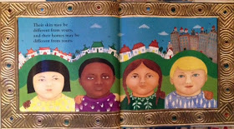
Whoever You Are
Notes:
The image from the book “ Whoever You Are”, expresses how children all over the world are diverse. The children in the image have different complexions. The children are also dressed in different types of clothing, some have short hair and others have long hair but all these differences only make them unique. They are all children with blood flowing in them and with all their biological processes being similar.

Slide 5
Whoever You Are
From the same image in the previous slide, it is also evident that the children are from different religious backgrounds
Some children worship in temples, other in mosques and others in churches
Children also study in different schools and live in different homes
However according to the author they are all the same “ their smiles are like yours. Their hurts are like yours, and they cry like you too” (Carlson 2)
Notes:
Smiles, hurts and tears therefore make all children the same despite them living in different geographical locations and having varied socio-cultural backgrounds

Slide 6
Whoever You Are
The book also honours the characteristics that we see in each other
It embraces our different personal attributes
It encourages us to embrace our unique qualities, while having a clear understanding that emotions, open hearts and love are found in all cultures
“Little one, wherever you are, wherever you go, there are little ones just like you all over the world” (Carlson 1)
Notes:
The quote is an illustration of the existing geographical and physical differences. Besides the differences, there are also similarities that will be found in all children all over the world regardless of their physical and geographical variations

Slide 7
Whoever You Are
Each page of the book also reveals the fascinating differences in the world we live in
Each page has colourful depictions of children shown in their native homes, countries and schools
The pictures are therefore a reminder to all readers of the book that we are indeed diverse around the world and our diversity is fantastic
“ Their skin may be different, their schools may be different, their words may be different…” (Carlson 12)
Notes:
This quote is a clear demonstration that there exists differences among us but the most important thing is that we should enjoy the fact that we are different as well as enjoy the similarities that we share.

Slide 8
Whoever You Are
“Smiles are the same, and hearts are just the same-wherever they are, wherever you are, wherever we are, all over the world” (Carlson 8)
The statement is repeated in the book to show how much children are the same
As much as different parts of the world, situations within which people are in and the activities people engage in at different times differ,
All people are the same in some aspects that are beyond human construction
Notes:
The statement is also an encouragement for children to love themselves as they are because they are just like their fellow children elsewhere in the world

Slide 9
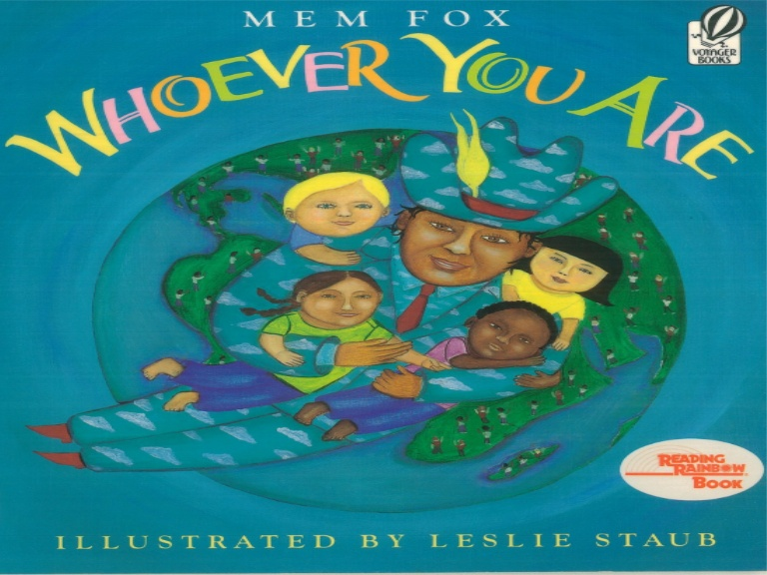
Whoever You Are
Notes:
The cover page of the book is itself an enough message of diversity. The writings “ Whoever You Are” are written in different colours and in different fonts. It is therefore evident that children can be of different body sizes but they are all important

Slide 10
Whoever You Are
The cover page has an image of an adult embracing children
The children are of a different complexion
The children are also dressed differently
The children have each a different hair type
The children also have different general looks with others being narrow-faced and other being broad-faced
The children are however all the same because “joy, love, pain, blood, smiles, and hearts are the same wherever you’ve been, wherever you are, and wherever you will be, whoever you are” (Carlson 32)
Notes:
The cover page therefore welcomes people of diverse backgrounds to study it. The author reveals on the cover page that she has no bias and the information in the text is meant for diverse groups of people.

Slide 11
Whoever You Are
“But inside, their hearts are just like yours, whoever they are, wherever they are, all over the world” (Carlson 13)
This statement is a reinforcement of the need for children to appreciate who they are Children are encouraged not to be uncomfortable with how they look and live as well as how their peers look and live
If any, then children should always be sure that the inside of all children is the same all over the world
Notes:
The repetition of the similarity of our internal beings, proves how the author of this book wanted its readers to understand that diversity exists and it is a beautiful thing. Diversity should therefore be appreciated

Slide 12
References
Carlson, Nancy L. ABC, I Like Me! Viking, 1997

